Slide 1
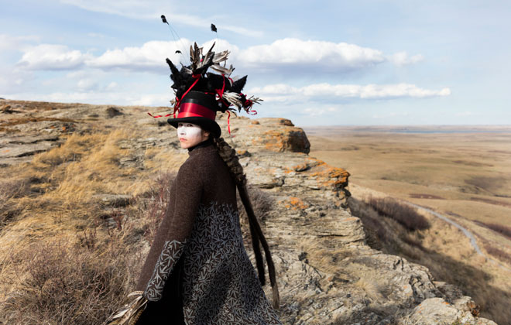
Meryl McMaster
Edge of a Moment
http://www.ago.net/every-now-then-reframing-nationhood

Slide 2
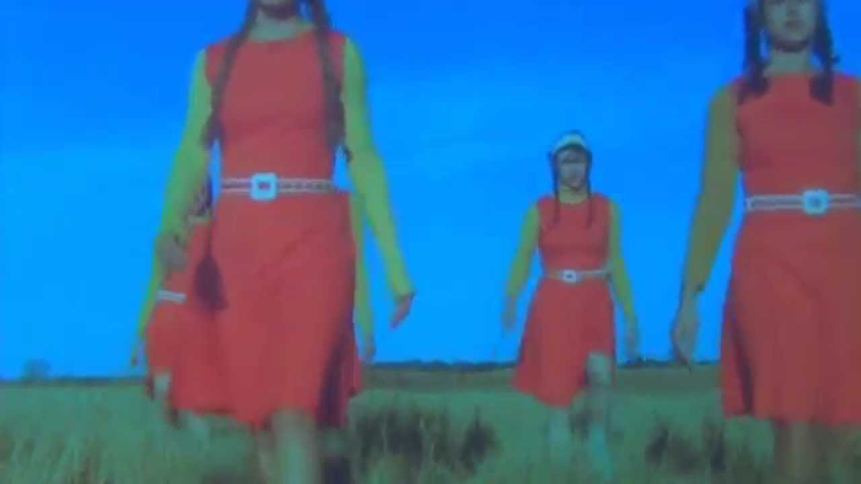
Amalie Atkins
Still from: we live on the edge of disaster and imagine we are in a musical
2013
https://www.youtube.com/watch?v=oi6WM_SGB_o

Slide 3
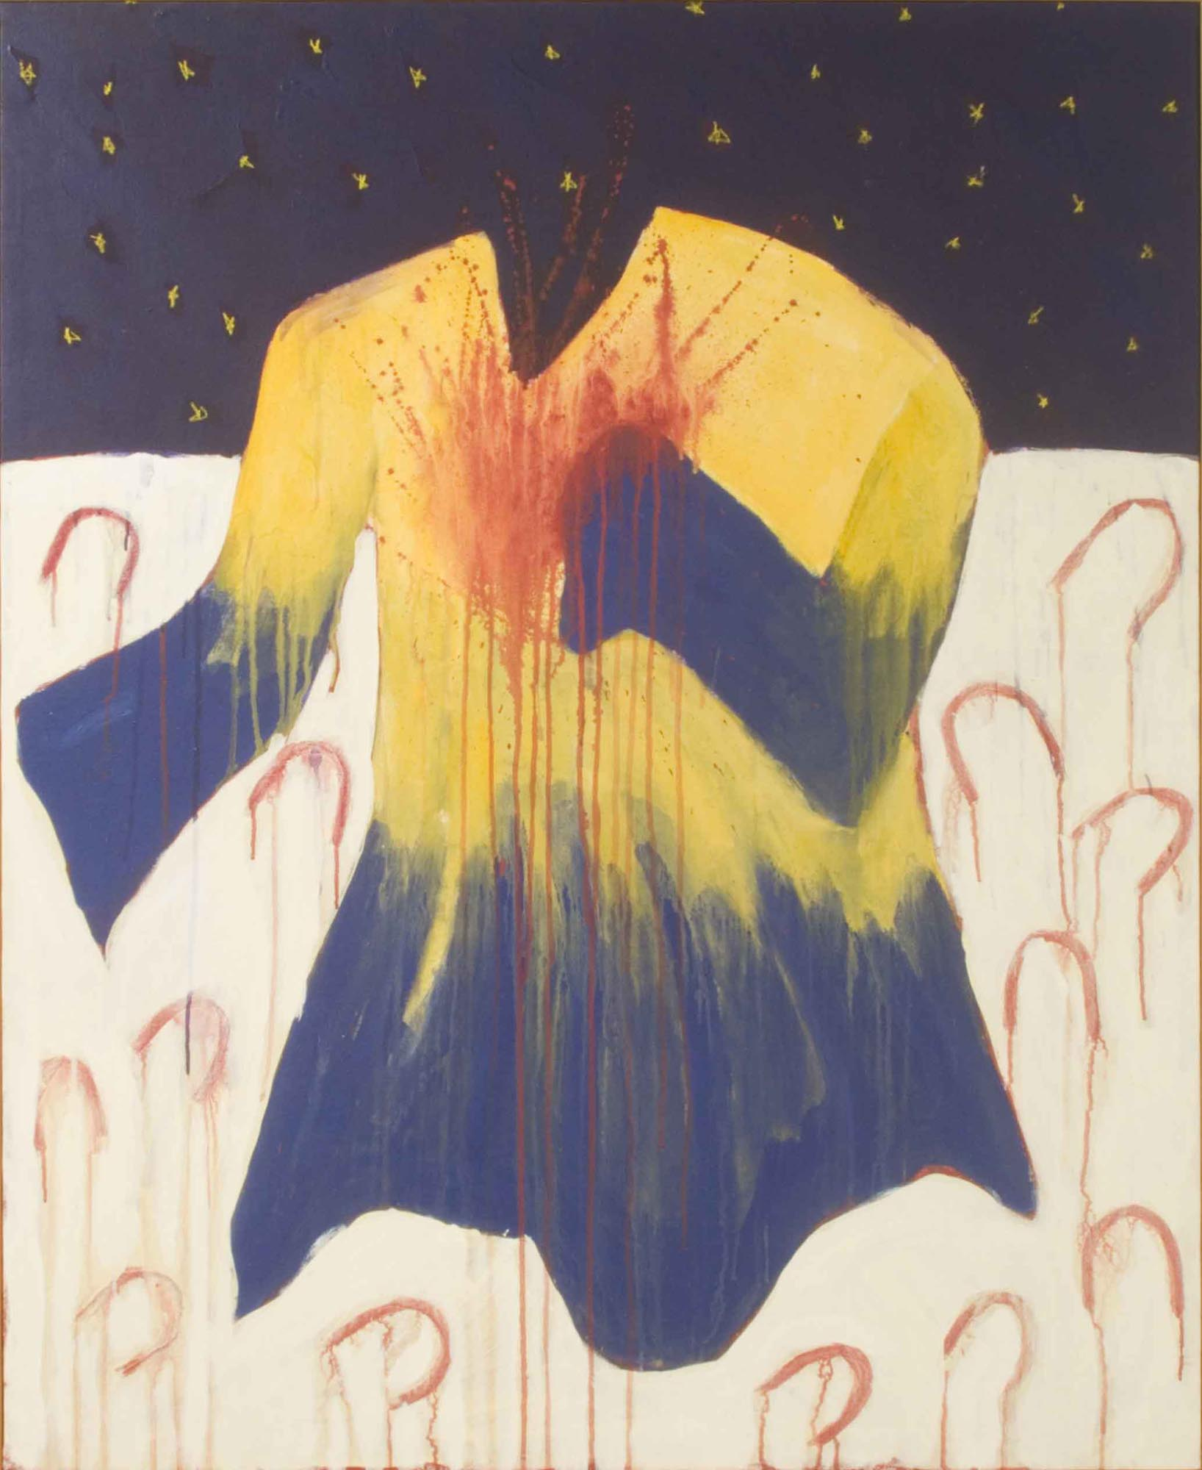
Ruth Cuthand
DANCE LITTLE HORSIE DANCE
1984

Slide 4
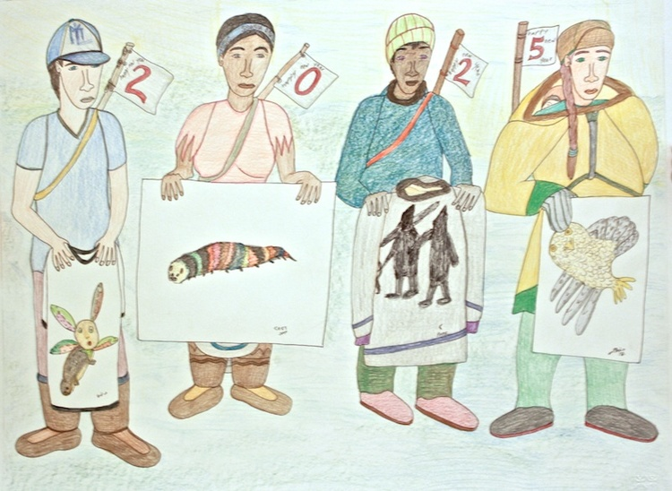
Shuvinai Ashoona
Untitled (148-1904)
Coloured Pencil on Paper

Slide 5
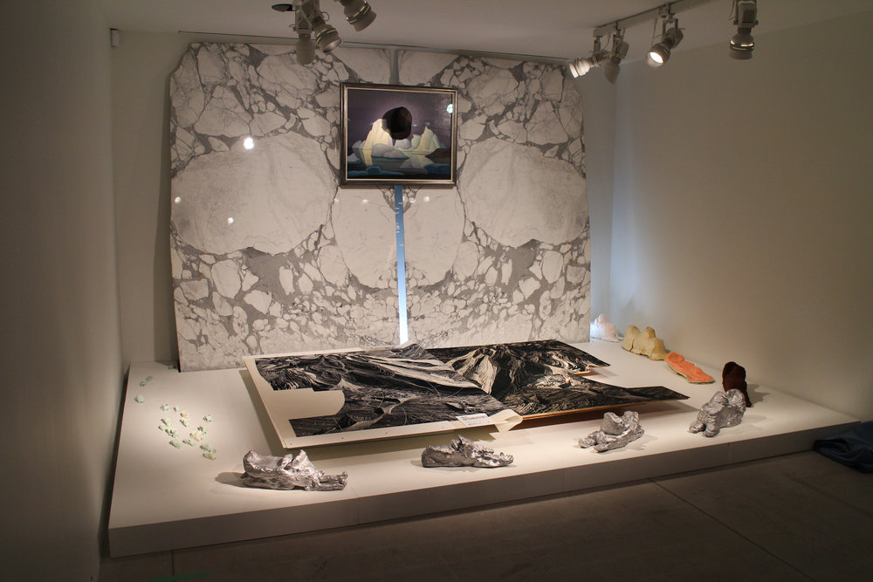
Towards Something New and Beautiful + Future Snowmachines in Kinngait
Installation
http://www.embassyofimagination.com/about/

Slide 6
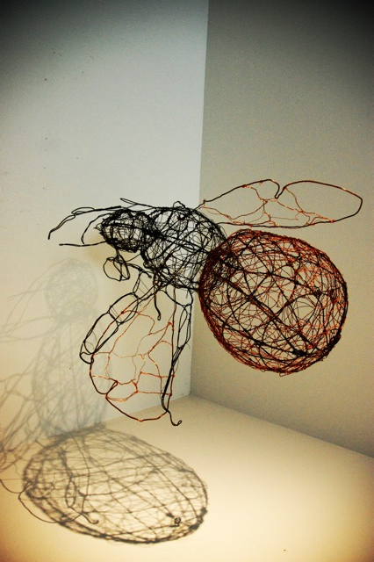
Nuit Blanche Wild Bees
Charmaine Lurch

Slide 7
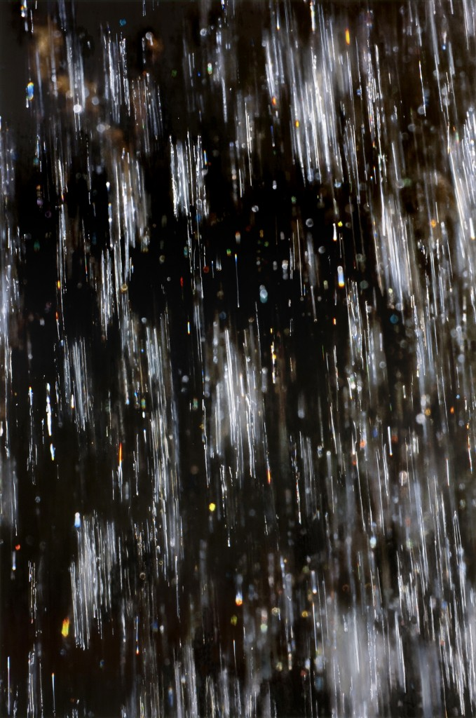
Laura Millard
From: Meltwater series

Slide 8
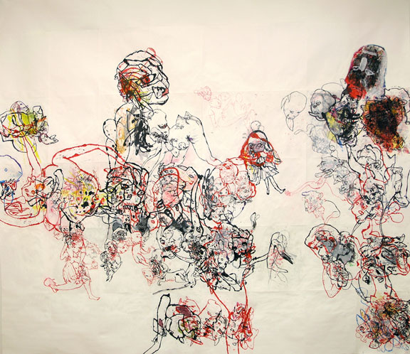
Ed Pien
The Offering
2009

Slide 9

Esm AA Mohamoud and Qendrim Hoiti
From: Basketball Performance

Slide 10
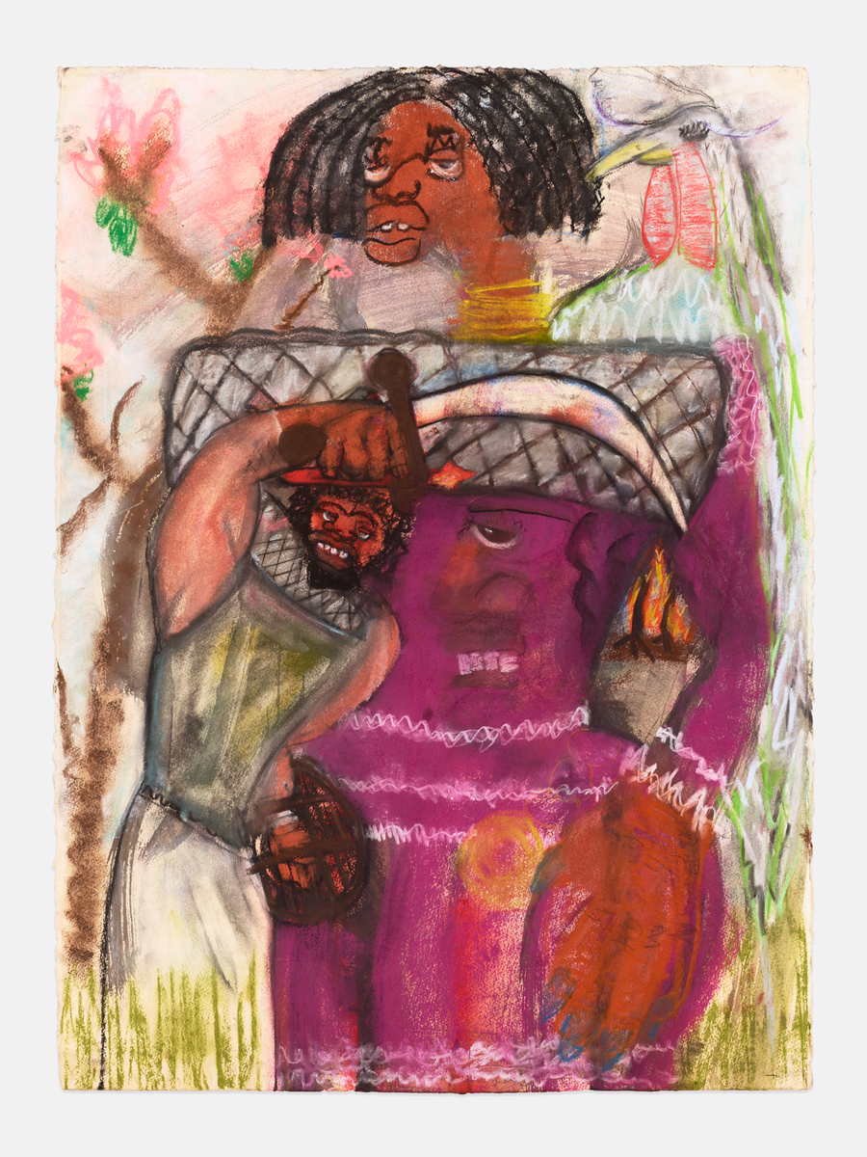
Curtis Talwst Santiago
Bloodlines I
2016

Slide 11
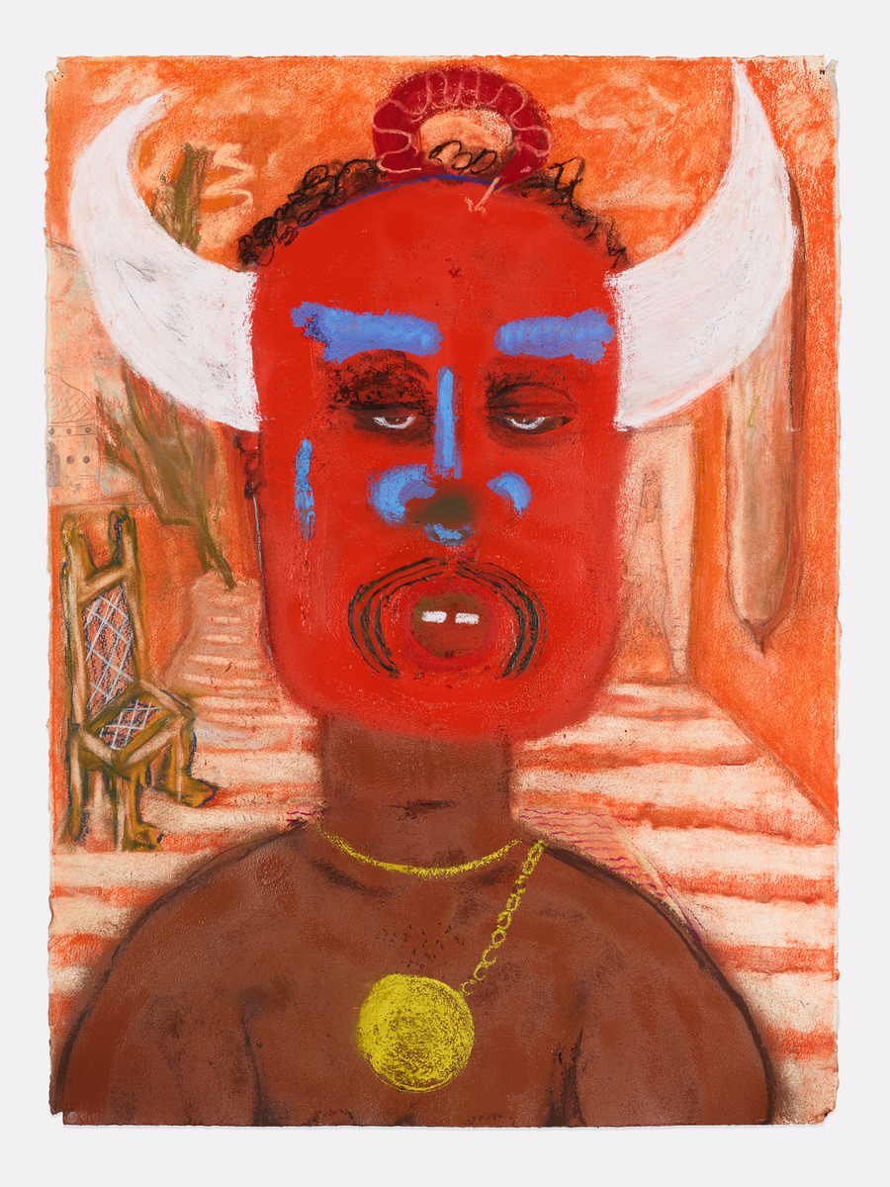
Me with Mask
2016

Slide 12
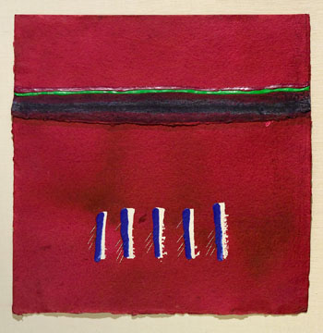
Robert Houle
Parfleches for the Last Supper #6: Andrew

Slide 13
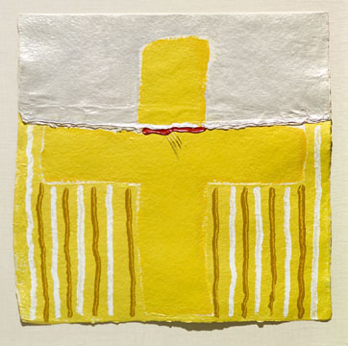
Robert Houle
Parfleches for the Last Supper #12: Jesus

Slide 14
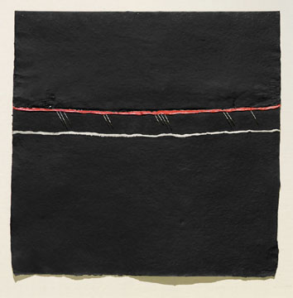
Robert Houle
Parfleches for the Last Supper #11: Judas

Slide 15
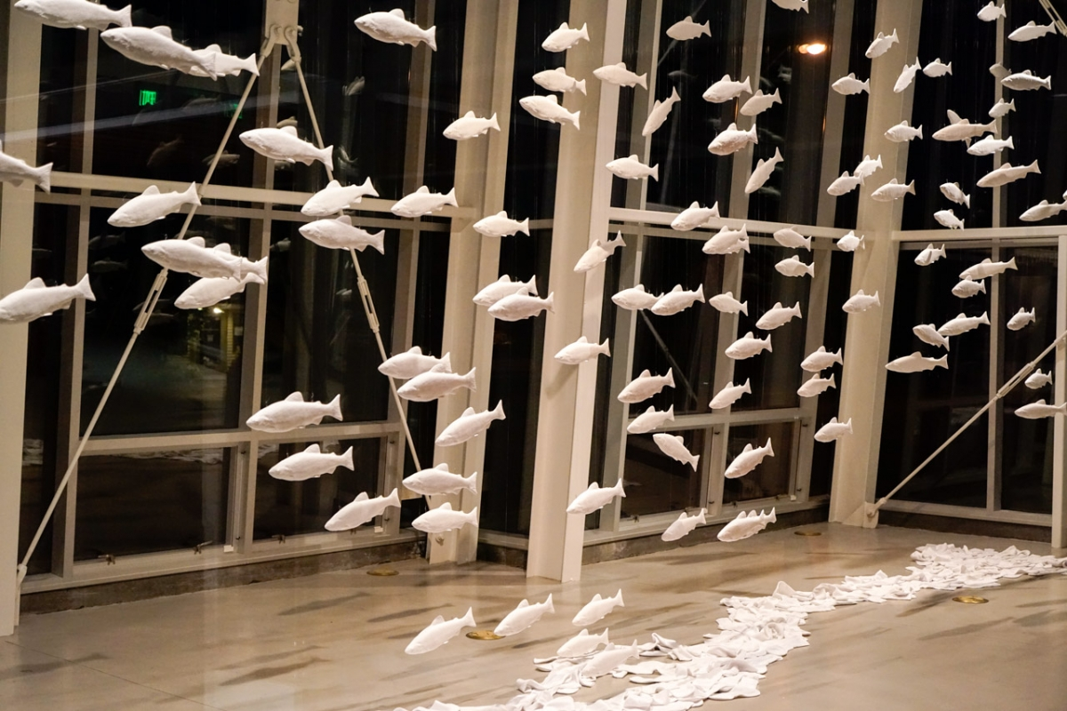
Gu Xiong
From: A River of Migration
2016
http://guxiong.ca/en/solo-exhibition/a-river-of-migration/

